Slide 1
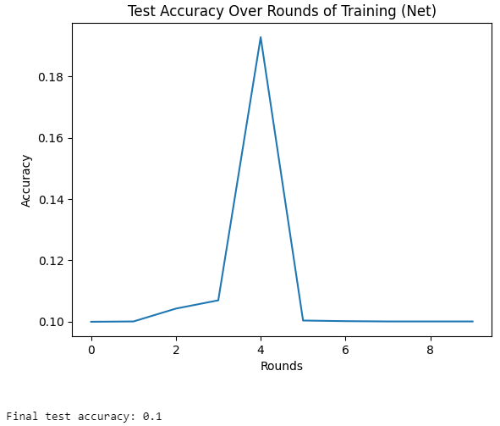
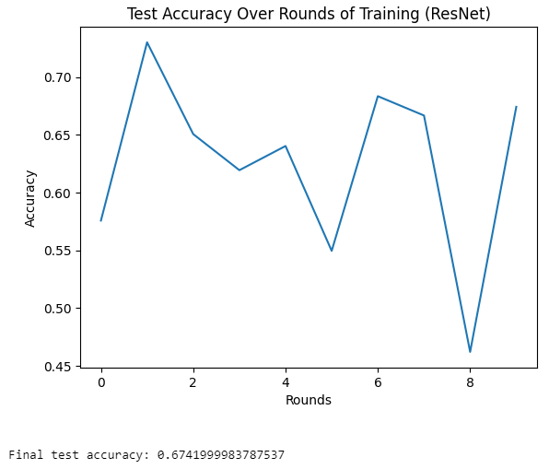
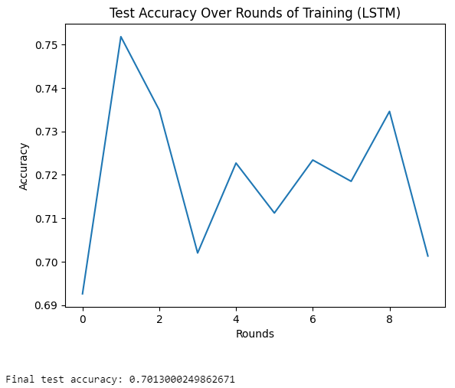
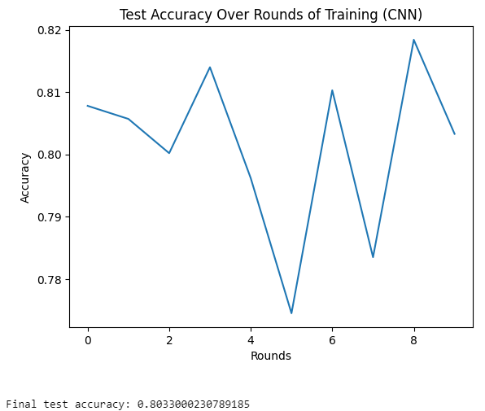
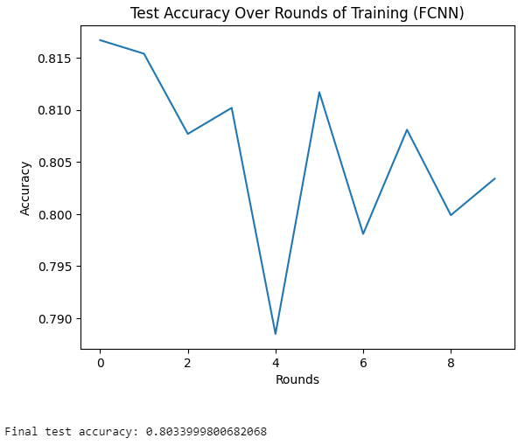
Model selection (based on FedSGD algorithm)
All experiments follow the principle of controlled variables, and the learning rate of its NET model is set to 0.01

Slide 2
Model result analysis
Model | Accuracy
Net | 0.1
ResNet | 0.6742
LSTM | 0.7013
CNN | 0.8033
FCNN | 0.8034
(1) Why is the final accuracy of the net model only 0.1?
Weight update strategy problem: The weight update strategy used in the code is to simply fuse the weight of the local model with the weight of the global model. This approach may not effectively integrate local updates across clients, especially when client data is unevenly distributed or the model is not sufficiently trained locally.
(2) Why are the LSTM and RESNET models not suitable for this task?
LSTM model: LSTM is a neural network specifically designed to process sequence data. Since Fashion-MNIST is an image classification task and image data does not have time dependence like sequence data, LSTM is not suitable for such image classification tasks.
ResNet model: Although ResNet is a very powerful image recognition model, it is designed to handle more complex and deeper image recognition tasks than Fashion-MNIST. For the relatively simple Fashion-MNIST data set, using ResNet may lead to unnecessary waste of computing resources, and the model may be too complex and prone to overfitting.

Slide 3
Model | Accuracy
Net | 0.1
ResNet | 0.6742
LSTM | 0.7013
CNN | 0.8033
FCNN | 0.8034
Model result analysis
(3) Why are the model of FCNN more accurate?
FCNN: Although generally FCNN is used for image segmentation tasks, in classification tasks, fully convolutional networks effectively learn the local features of images by leveraging their spatial hierarchical performance, thereby achieving high accuracy.
(4) Why is CNN more suitable than other models for processing the Fashion-MNIST data set when choosing a model architecture?
①Feature extraction capability: CNN automatically extracts important features from images through convolutional layers without manually designing feature extractors, which is very important for Fashion-MNIST images containing complex patterns and styles.
② Model complexity and computational efficiency: CNN models can be designed to be relatively lightweight, fast in training, and easy to debug and optimize.
③Local connection and weight sharing: These two characteristics of CNN reduce the number of parameters of the model and improve its generalization ability. This means that the CNN is better able to learn from limited training samples and reduces the risk of overfitting.
④Spatial hierarchy: Through multi-layer convolution and pooling operations, CNN is able to capture the hierarchical structure in the image, from simple edges to complex shapes and patterns. This is very useful for clothing image classification in Fashion-MNIST because clothing images contain various shapes and textures.

Slide 4
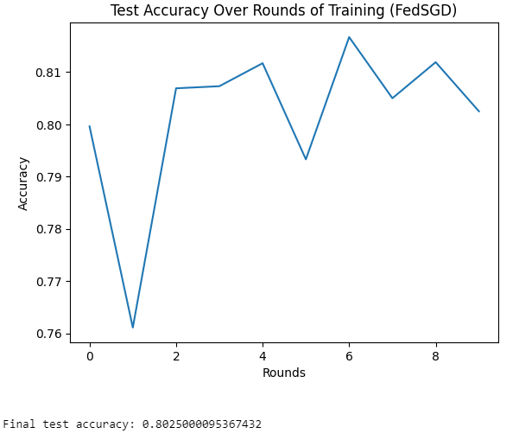
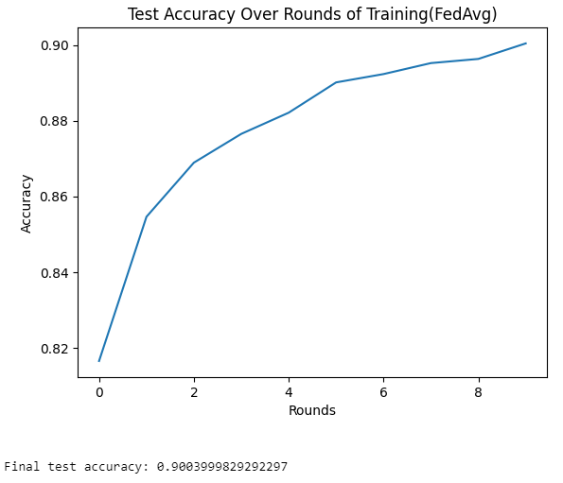
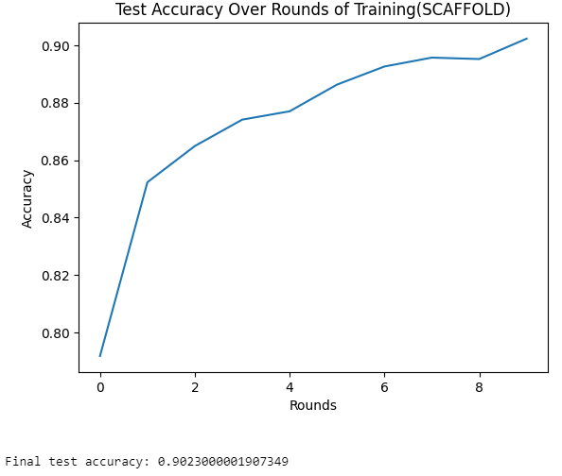
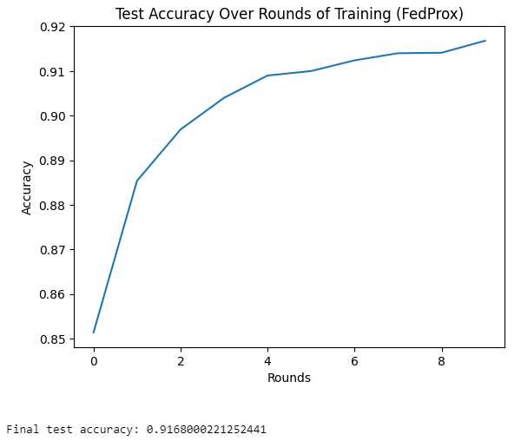
Algorithm comparison (based on CNN model)
All experiments follow the principle of controlled variables.

Slide 5
Algorithm result analysis
Algorithm | Accuracy
FedSGD | 0.8025
FedAvg | 0.9004
ScafFold | 0.9023
FedProx | 0.9168
(1) Why does the FedSGD algorithm have the lowest final accuracy?
The FedSGD algorithm works by completing a gradient update independently on each client and then sending all clients' updates to a central server for averaging. A major drawback of this approach is that it does not take into account the non-IID nature of the data across clients. In this project, each client may have data with different characteristics, which will cause the features learned by the model during local updates to be non-universal, thus affecting the performance and generalization ability of the overall model.
(2) Why are FedAvg and SCAFFOLD obviously different algorithms, but their final accuracy is almost the same?
The FedAvg algorithm improves upon FedSGD by running multiple local iterations on each client and then averaging these updates. This approach can reduce communication costs and allow more complex local model training, thereby improving model performance.
The SCAFFOLD algorithm further optimizes the federated learning process by introducing control variables to correct deviations in client updates, which helps to deal with the problem of non-independent and identically distributed data.
However, although SCAFFOLD provides better bias correction in theory, its performance in this project may be similar to FedAvg. This may be because the FedAvg algorithm has been fully adapted to the FedAvg algorithm in data sets such as Fashion-MNIST, making both The performance is close.

Slide 6
Algorithm result analysis
Algorithm | Accuracy
FedSGD | 0.8025
FedAvg | 0.9004
ScafFold | 0.9023
FedProx | 0.9168
(3) Why does the FedProx algorithm have the highest final accuracy?
The FedProx algorithm is a variant of FedAvg, which handles heterogeneous data, that is, differences in data distribution on different clients, by adding a regularization term to local updates. This regularization term helps stabilize the training process and ensures smoother and more consistent model updates for each client, even in the presence of large differences in data distribution. This approach improves the model's robustness and ultimate performance on diverse data sources, especially when faced with Fashion-MINST data that is common in the real world.

